Slide 1
Web Development Internship
NAME: Anirudh.S.P USN: 4MT21CS024
NAME: Shravya Devadiga USN:4MT21CS150
PROJECT: Services offered by Google

Slide 2

PROJECT: SERVICES PROVIDED BY GOOGLE
TABLE OF CONTENTS
MIND MAP
INTRODUCTION
WEBSITE INFO
ABOUT US
AWARDS
CONTACT
LEARNINGS
CONCLUSION

Slide 3
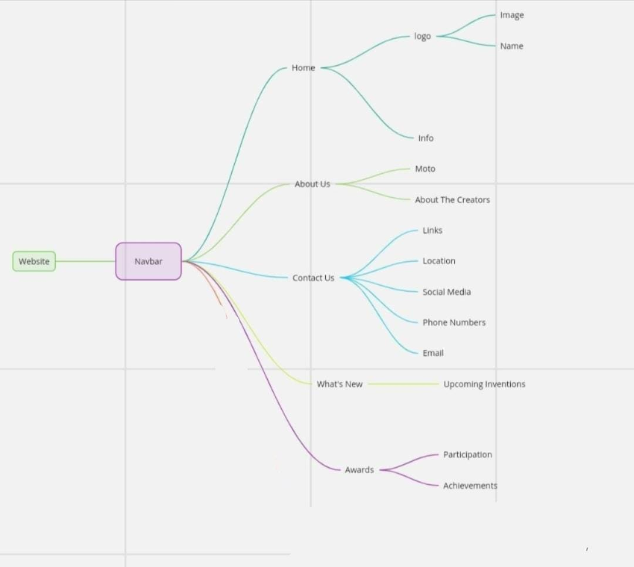
Mind map diagram

Slide 4
INTRODUCTION
Key points for your website introduction PPT:
1. Hook the audience:
Start "Imagine a world where information is at your fingertips, where navigation is effortless, and where entertainment thrives – that's the world powered by Google."
  "From humble beginnings to a global giant, Google's journey is one of innovation, connection, and empowerment. Let's dive into the services that revolutionize our daily lives."
  "Is there anything Google can't do? Explore the vast universe of Google's offerings, from entertainment to storage, and discover how it shapes our world."
Google Mobile Ads integrates advertisements into applications, allowing monetization by targeting ads based on factors such as user location. The Google Pay API allows purchases of services and goods via Google Pay. Other APIs include the Google Fit API, account authentication methods, and Google Analytics.

Slide 5
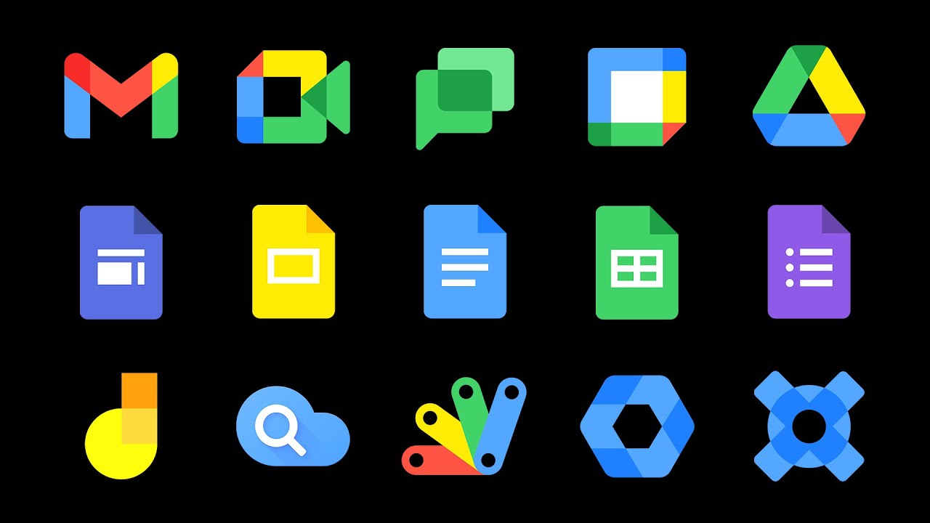
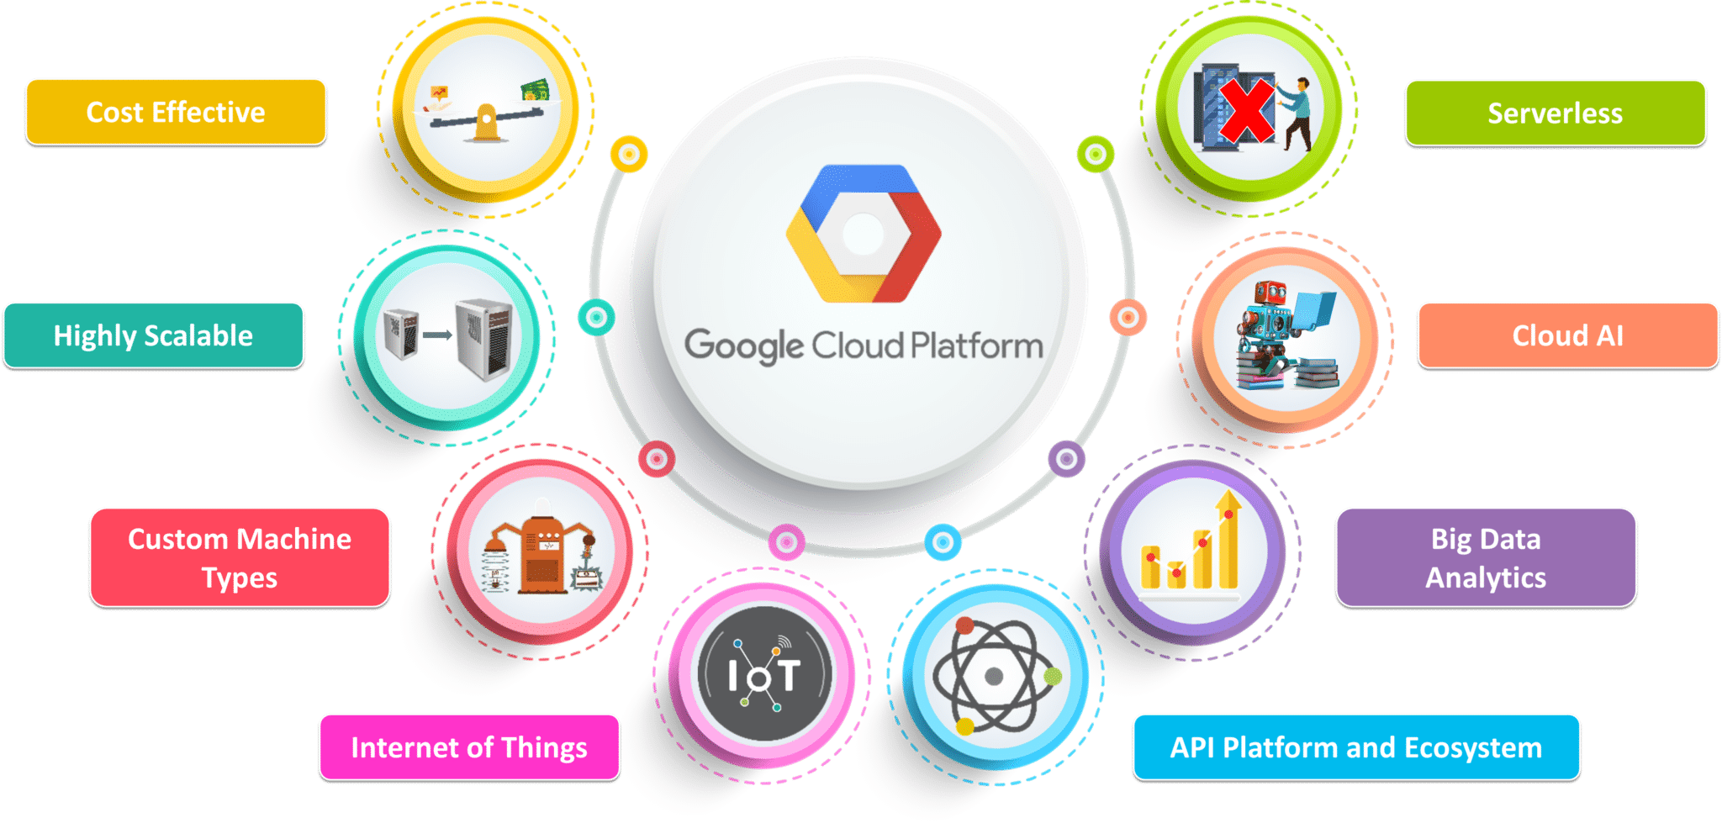
INTRODUCTION (contd..)
The “Main Core Services” (as used in the table below) are: Cloud Identity Services, Gmail, Google Calendar, Google Chat, Google Contacts, Google Docs, Google Drive, Google Forms, Google Groups for Business, Google Jamboard, Google Keep, Google Meet, Google Sheets, Google Sites, Google Slides, and Google Tasks.

Slide 6
WEBSITE
This website mainly provides the information about Google and also the services that are been provided by Google.
Well there are innumerous services that the Google offers to the users. This website just provides the information about those applications.
In this website the starting page a user see is the home page. Here the user can explore the website by clicking on ‘explore here’.
There are many different names at the top of the page such as About, Awards, Contact etc. You can just click on the tags and it will direct you to that particular page.
Following shows an glimpse of the home page.

Slide 7
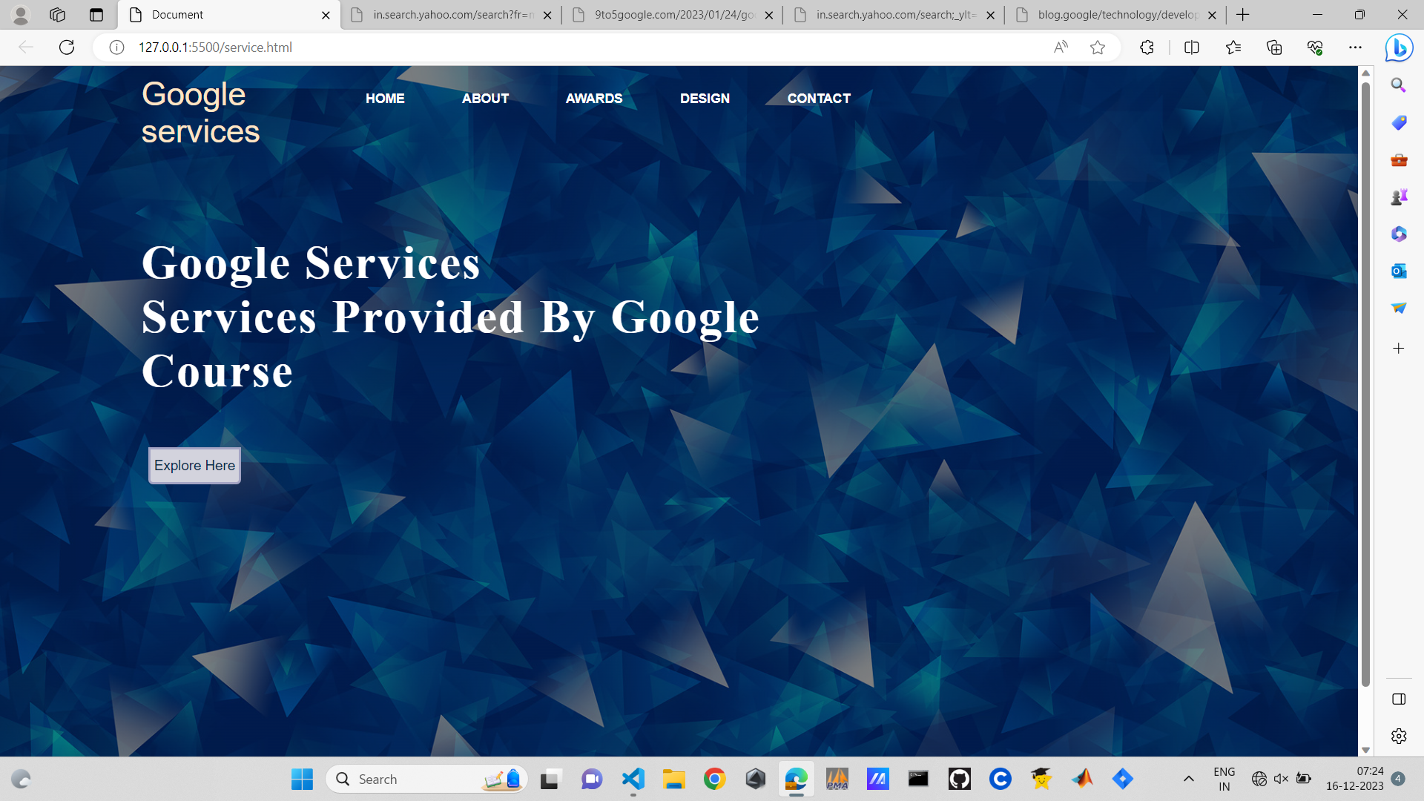
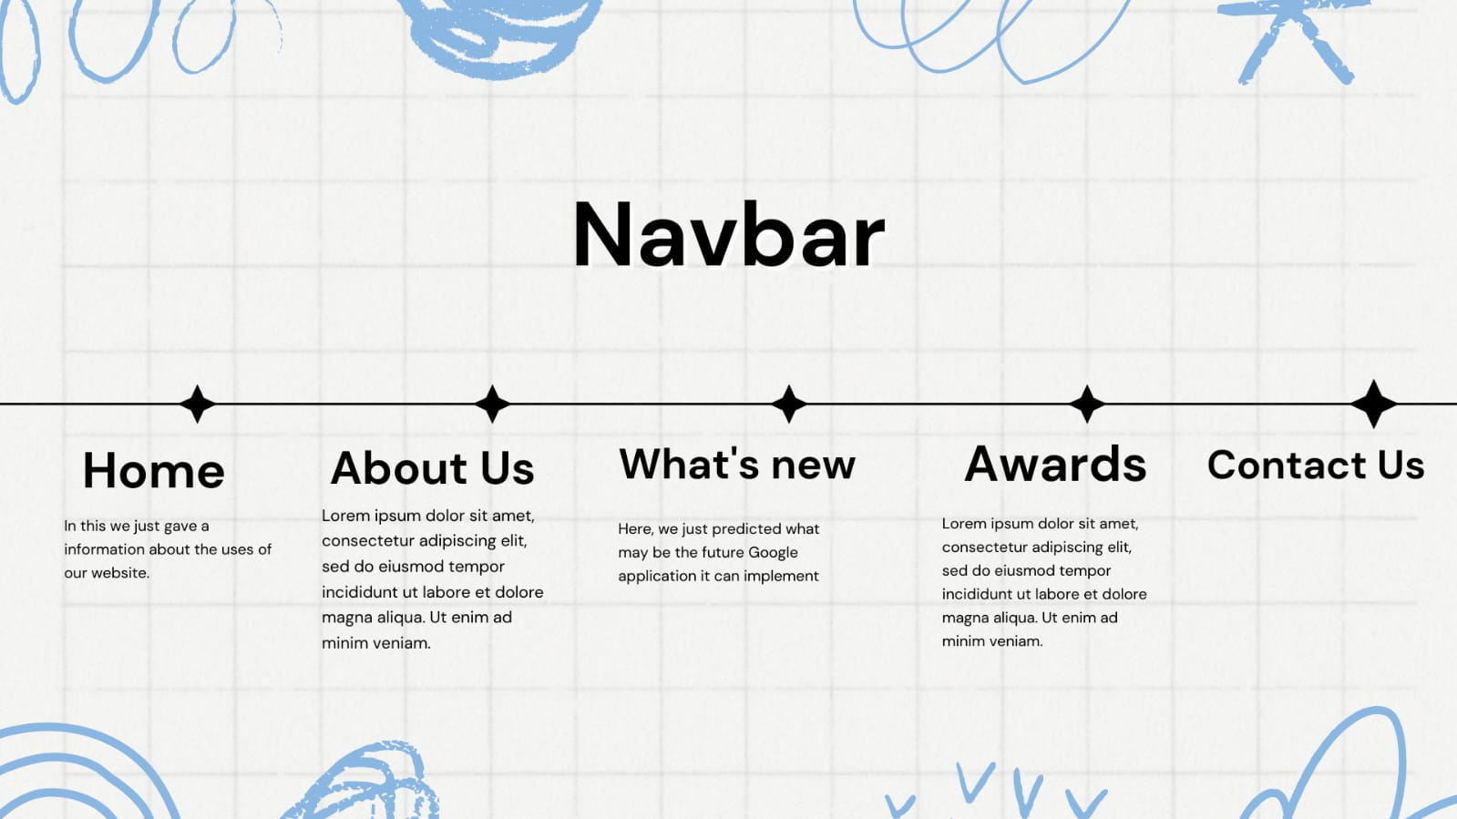
WEBSITE(CONTD.)

Slide 8
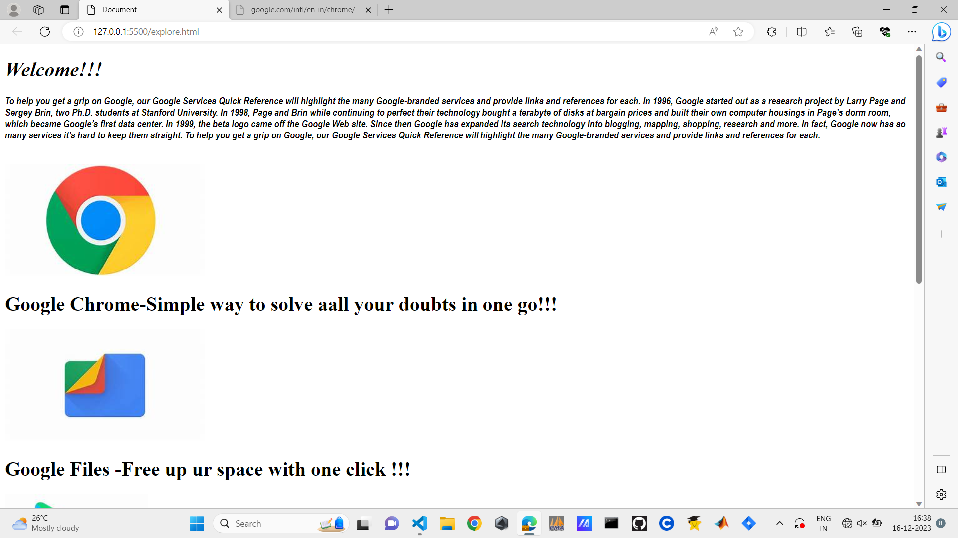
Website(contd.)
THE EXPLORE BUTTON:
When we click on the ‘Explore here’ button you will be directed to a page where there is some details given about some of the applications of google.

Slide 9
WEBSITE(CONTD.)
ABOUT
we would like to give awareness to the people about the various Google application, which are not only safe but also very trust worthy.
CONTACT
In the contact section we have added the email and phone number in order to contact.

Slide 10
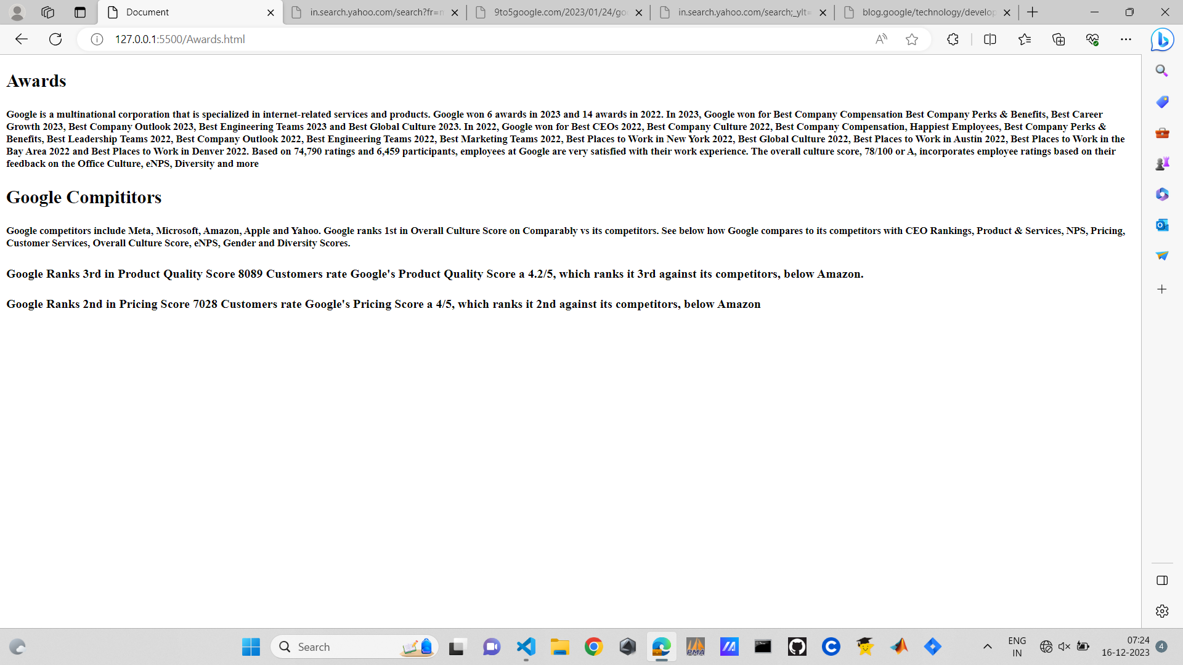
Website (contd.)
AWARDS AND COMPETITORS
Google is a big brand now and since it has many services and applications, it is globally famous and used in every corner of the world.
It has won many awards which is also showcased in the awards section of the website.
Since this is a company it will have many competitors which are also as strong as Google itself. There are competitors like Meta, Microsoft, Amazon, Apple and Yahoo.
Even though there are many competitors Google is ranked 1st in overall culture score. This website showcases the achievements of google and provides information about it.

Slide 11

learnings
It was an amazing experience learning about the web development.
We got to know about the development of applications and how to use it in solving the real world problems.
The website we created using front end programming languages was actually interesting to work with.
The website is a simplified form of web page that will provide the details about the services provided by Google.

Slide 12

conclusion
Overall conclusion of this website is that –it is a website of information.
The website tells about the services of google, achievements and awards received by google, various competitors of it and the contact in formation.
Google does not stop here. It creates many more solutions to the problems which the world is facing. It is a continuous innovation centre.
To keep the users updated about the services of google we have created this website.
This is the use of learning development of web applications because with this we can reach the world where several can see the work that we want them to see and acknowledge.

Slide 13


